Slide 1


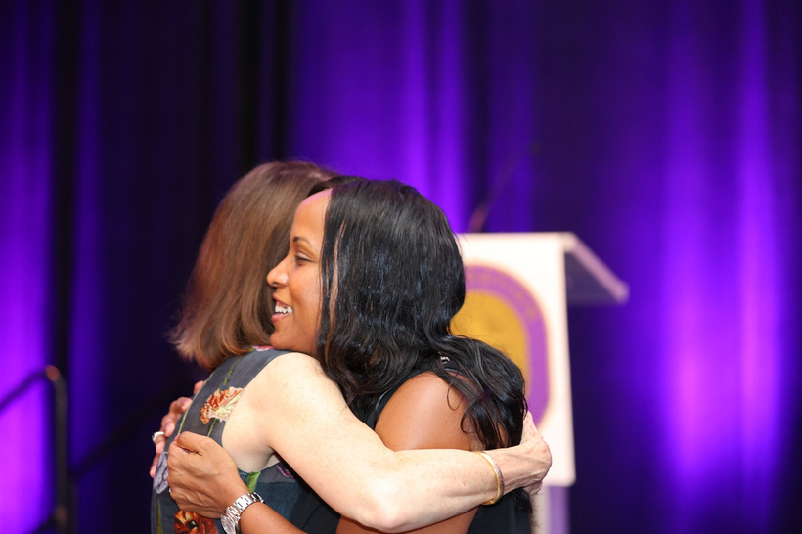
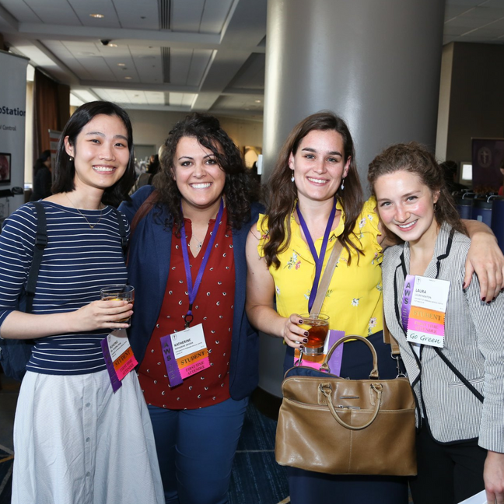
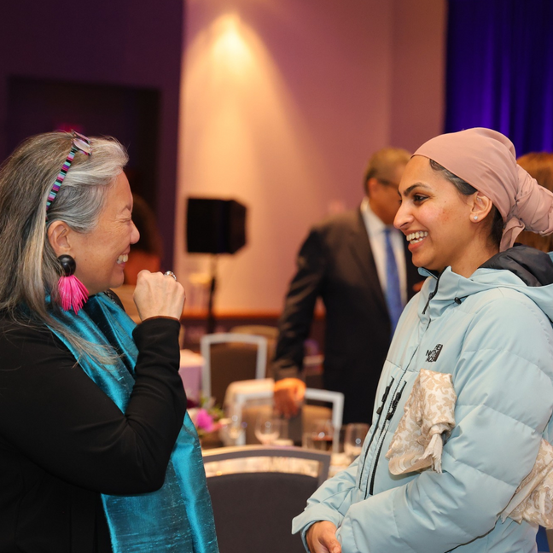

ASSOCIATION of WOMEN SURGEONS
Mentorship
Friendship
Sponsorship
Build Community & Advance Your Career
Join AWS Today!
womensurgeons.org

